Slide 1

Business Statistics, 5th ed. by Ken Black
Chapter 10
Statistical
Inferences about Two Populations
PowerPoint presentations prepared by Lloyd Jaisingh, Morehead State University

Slide 2
Learning Objectives
Test hypotheses and construct confidence intervals about the difference in two population means using the Z statistic.
Test hypotheses and construct confidence intervals about the difference in two population means using the t statistic.
Notes:
2

Slide 3
Learning Objectives
Test hypotheses and construct confidence intervals about the difference in two related populations.
Test hypotheses and construct confidence intervals about the differences in two population proportions.
Test hypotheses and construct confidence intervals about two population variances.

Slide 4


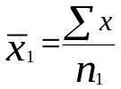




Sampling Distribution of the Difference Between Two Sample Means
Population 1
Population 2
Notes:
3

Slide 5
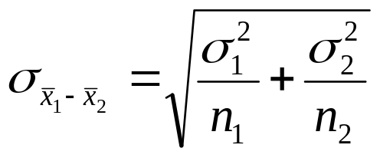
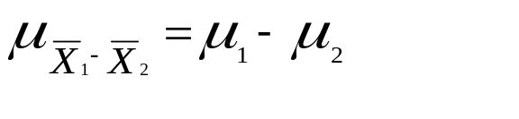
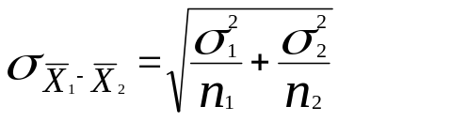
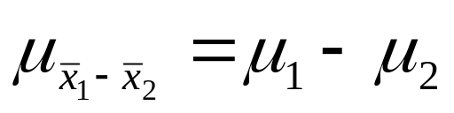



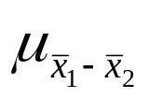
Sampling Distribution of the Difference between Two Sample Means
Notes:
4

Slide 6
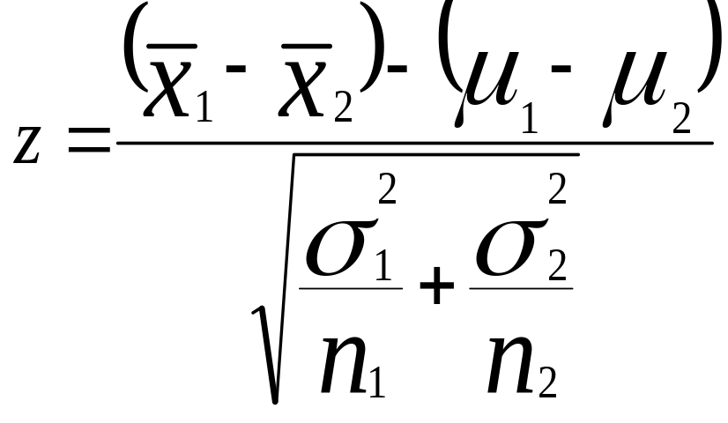
Z Formula for the Difference in Two Sample Means
When σ₁² andσ₂² are known and Independent Samples
Notes:
5

Slide 7
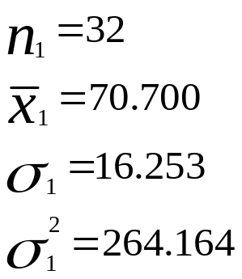
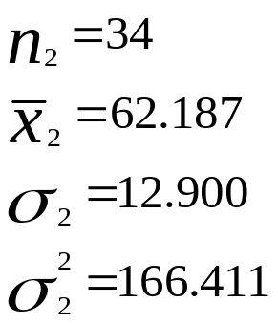
Hypothesis Testing for Differences Between Means: The Wage Example
Advertising Managers
74.256 | 57.791 | 71.115
96.234 | 65.145 | 67.574
89.807 | 96.767 | 59.621
93.261 | 77.242 | 62.483
103.030 | 67.056 | 69.319
74.195 | 64.276 | 35.394
75.932 | 74.194 | 86.741
80.742 | 65.360 | 57.351
39.672 | 73.904
45.652 | 54.270
93.083 | 59.045
63.384 | 68.508
Auditing Managers
69.962 | 77.136 | 43.649
55.052 | 66.035 | 63.369
57.828 | 54.335 | 59.676
63.362 | 42.494 | 54.449
37.194 | 83.849 | 46.394
99.198 | 67.160 | 71.804
61.254 | 37.386 | 72.401
73.065 | 59.505 | 56.470
48.036 | 72.790 | 67.814
60.053 | 71.351 | 71.492
66.359 | 58.653
61.261 | 63.508
Notes:
8

Slide 8
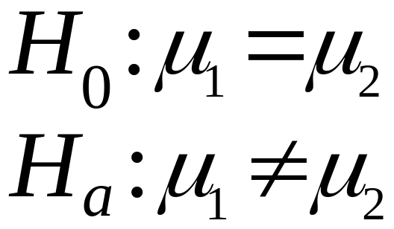
Hypothesis Testing for Differences Between Means: The Wage Example
α =0.05, α/2 = 0.025, z_{0.025} = ±1.96

Slide 9
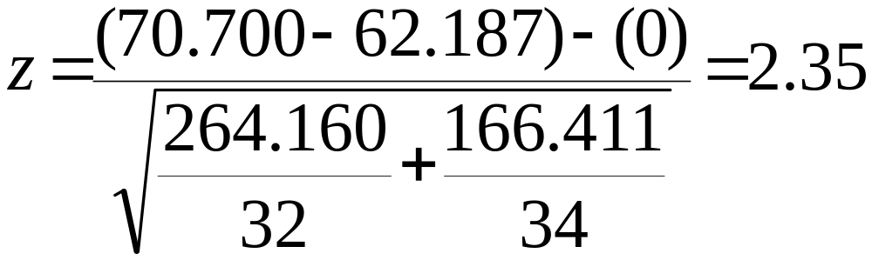
Hypothesis Testing for Differences Between Means: The Wage Example
Since the observed value of 2.35 is greater than 1.96,
reject the null hypothesis. That is, there is a significant
difference between the average annual wage of advertising
managers and the average annual wage of an auditing manager.

Slide 10
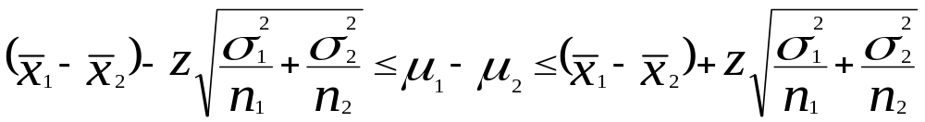
Confidence Interval to Estimate μ₁ - μ₂ When σ₁, σ₂ are known
Notes:
12

Slide 11
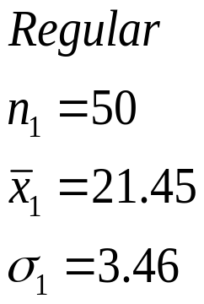
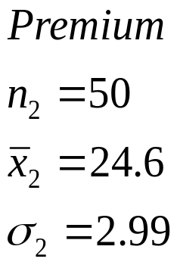
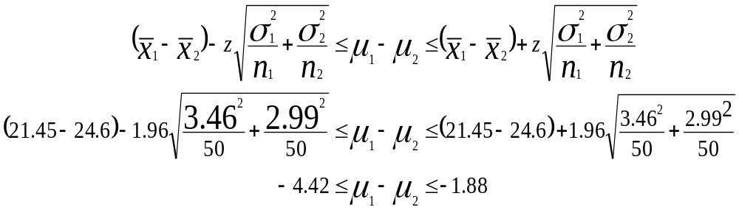
Demonstration Problem 10.2
Notes:
13

Slide 12
The t Test for Differences in Population Means
Each of the two populations is normally distributed.
The two samples are independent.
The values of the population variances are unknown.
The variances of the two populations are equal. σ₁² = σ₂²
Notes:
14

Slide 13
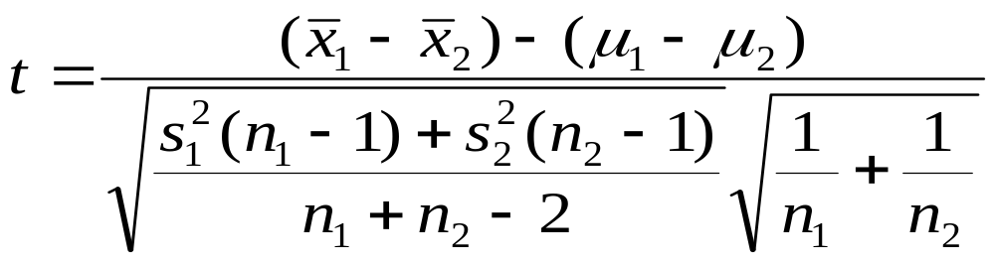
t Formula to Test the Difference in Means Assuming σ₁² = σ₂²
Notes:
15

Slide 14
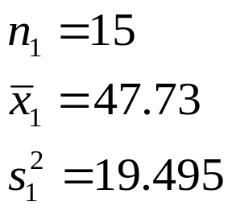
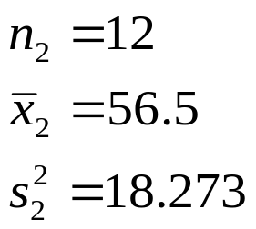
Hernandez Manufacturing Company
Training Method A
Training Method B
56
51
45
59
57
53
47
52
43
52
56
65
42
53
52
53
55
53
50
42
48
54
64
57
47
44
44
Notes:
17

Slide 15
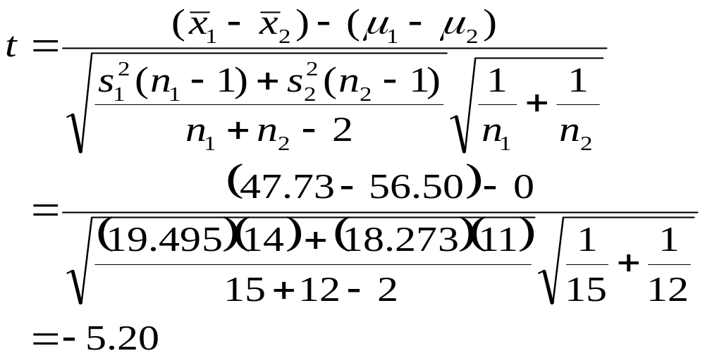
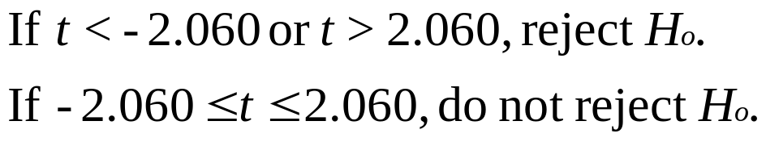
Hernandez Manufacturing Company (part 3)
Notes:
18

Slide 16
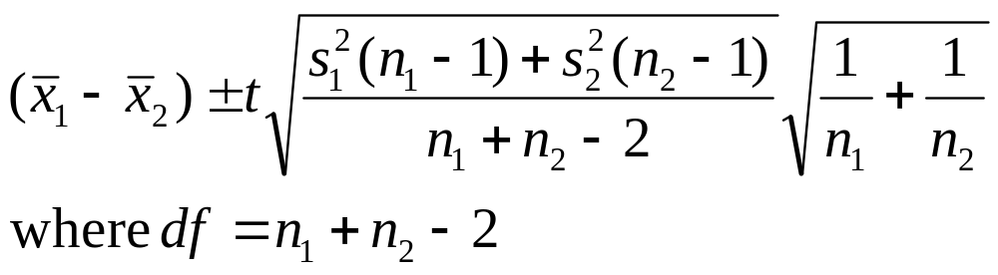
Confidence Interval to Estimate μ₁ - μ₂ when σ₁² and σ₂² are unknown and σ₁² = σ₂²
Notes:
21

Slide 17
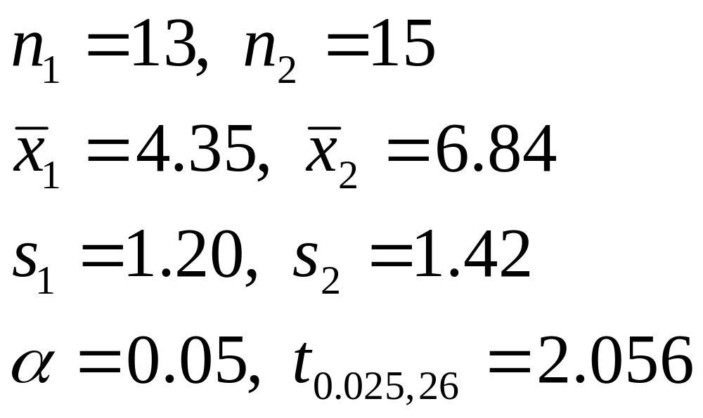
Demonstration Problem 10.4
Notes:
21

Slide 18
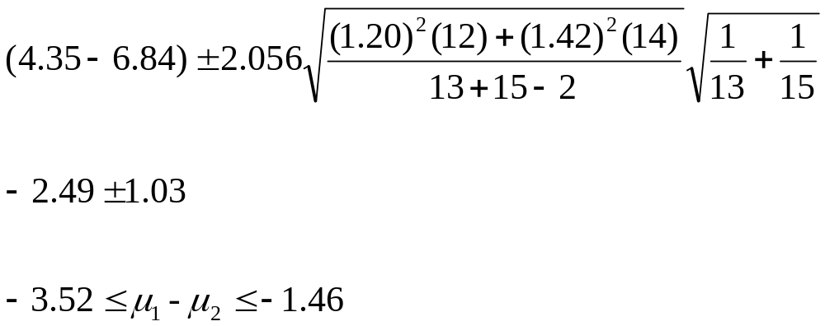
Demonstration Problem 10.4
The researcher is 95% confident that the difference in population
average daily consumption of cups of coffee between regular- and
decaffeinated-coffee drinkers is between 1.46 cups and 3.52 cups.
Notes:
21

Slide 19
Dependent Samples
Before and after measurements on the same individual
Studies of twins
Studies of spouses
Individual
Before
After
1
2
3
4
5
6
7
32
11
21
17
30
38
14
39
15
35
13
41
39
22
Notes:
25

Slide 20
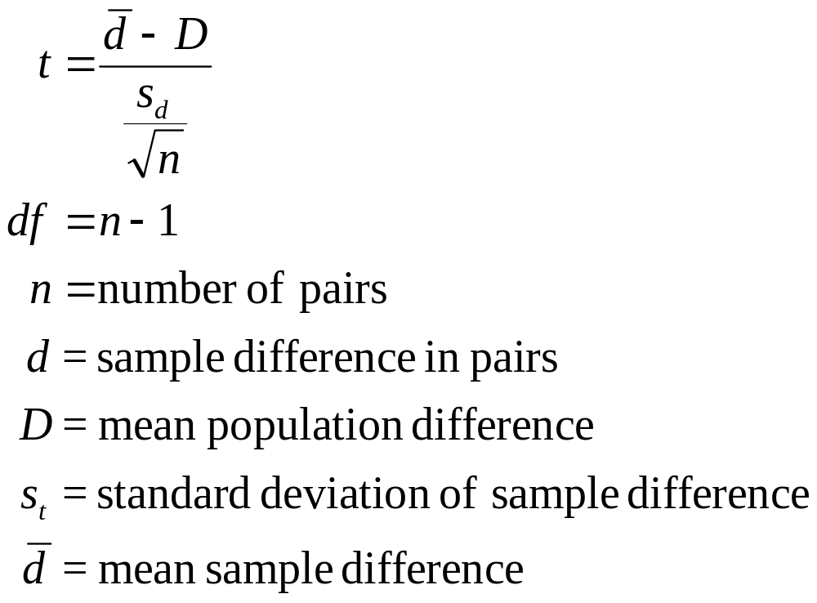
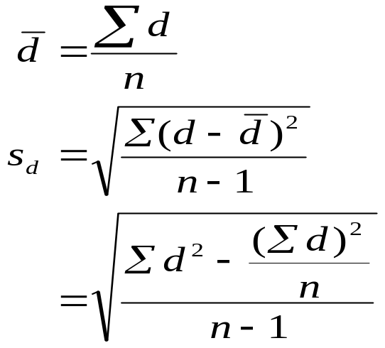
Formulas for Dependent Samples
Notes:
26

Slide 21
P/E Ratios for Nine Randomly Selected Companies
Company | Year1 P/E Ratio | Year2 P/E Ratio
1 | 8.9 | 12.7
2 | 38.1 | 45.4
3 | 43.0 | 10.0
4 | 34.0 | 27.2
5 | 34.5 | 22.8
6 | 15.2 | 24.1
7 | 20.3 | 32.3
8 | 19.9 | 40.1
9 | 61.9 | 106.5

Slide 22
Hypothesis Testing with Dependent Samples: P/E Ratios for Nine Companies
Company | Year1 P/E Ratio | Year2 P/E Ratio | d
1 | 8.9 | 12.7 | -3.8
2 | 38.1 | 45.4 | -7.3
3 | 43.0 | 10.0 | 33.0
4 | 34.0 | 27.2 | 6.8
5 | 34.5 | 22.8 | 11.7
6 | 15.2 | 24.1 | -8.9
7 | 20.3 | 32.3 | -12.0
8 | 19.9 | 40.1 | -20.2
9 | 61.9 | 106.5 | -44.6

Slide 23
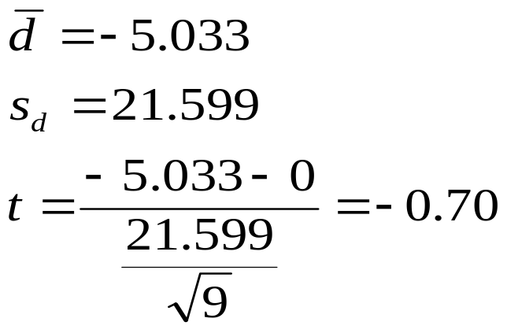
Hypothesis Testing with Dependent Samples: P/E Ratios for Nine Companies
H₀: D = 0
H₁: D ≠ 0
Notes:
29

Slide 24
Hypothesis Testing with Dependent Samples: Demonstration Problem 10.5
Individual
Before
After
d
1
2
3
4
5
6
7
32
11
21
17
30
38
14
39
15
35
13
41
39
22
-7
-4
-14
4
-11
-1
-8
Notes:
25

Slide 25
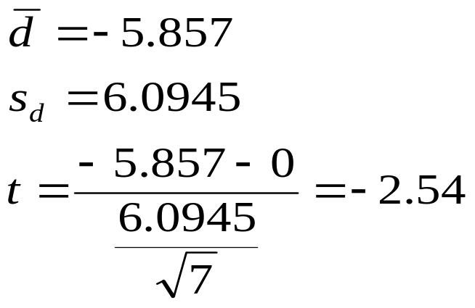
Hypothesis Testing with Dependent Samples: Demonstration Problem 10.5
H₀: D = 0
H₁: D < 0
Notes:
33

Slide 26
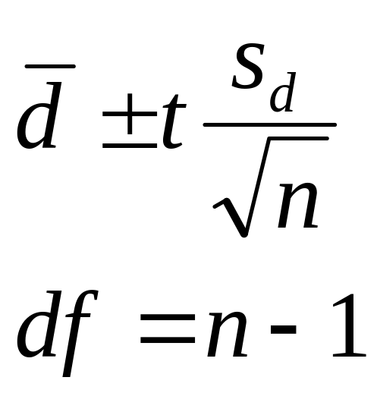
Confidence Intervals

Slide 27
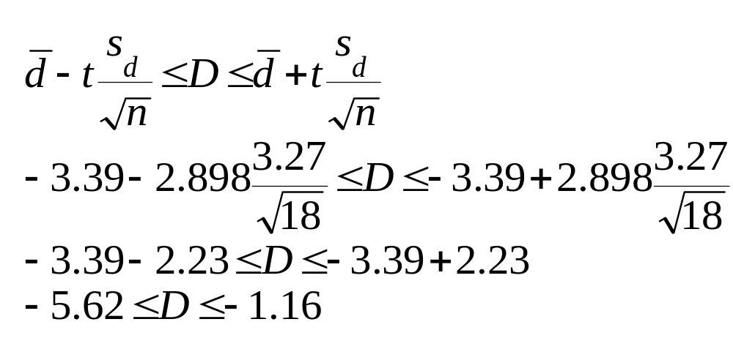
Confidence Intervals
The analyst estimates with a 99% level of confidence that the
average difference in new-house sales for a real estate company in
Indianapolis between 2005 and 2006 is between -5.62 and -1.16
houses.

Slide 28
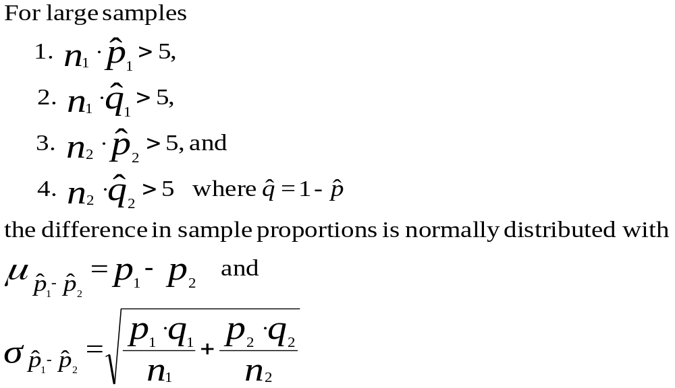
Sampling Distribution of Differences in Sample Proportions
Notes:
39

Slide 29
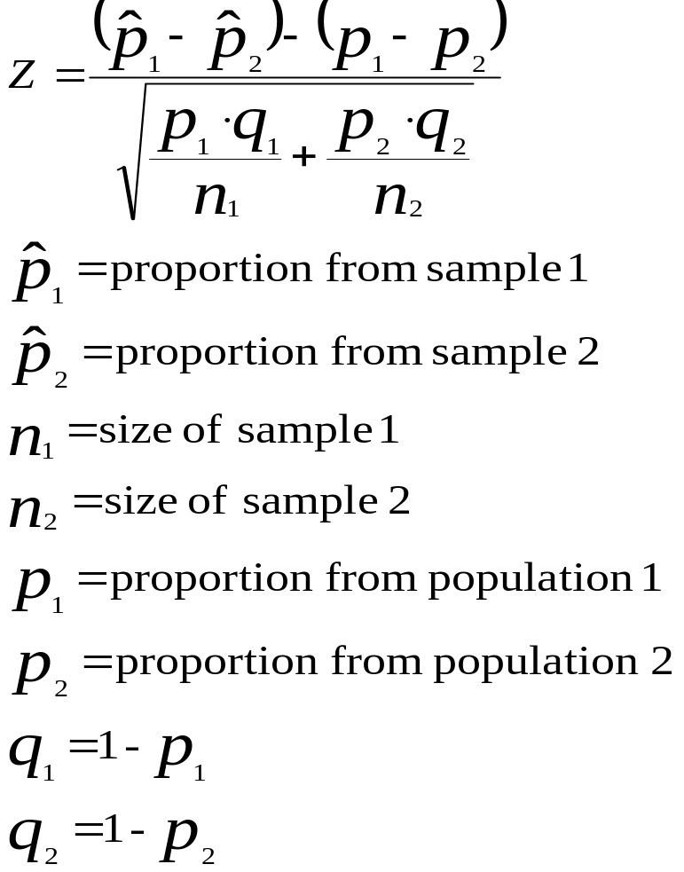
Z Formula for the Difference in Two Population Proportions
Notes:
40

Slide 30
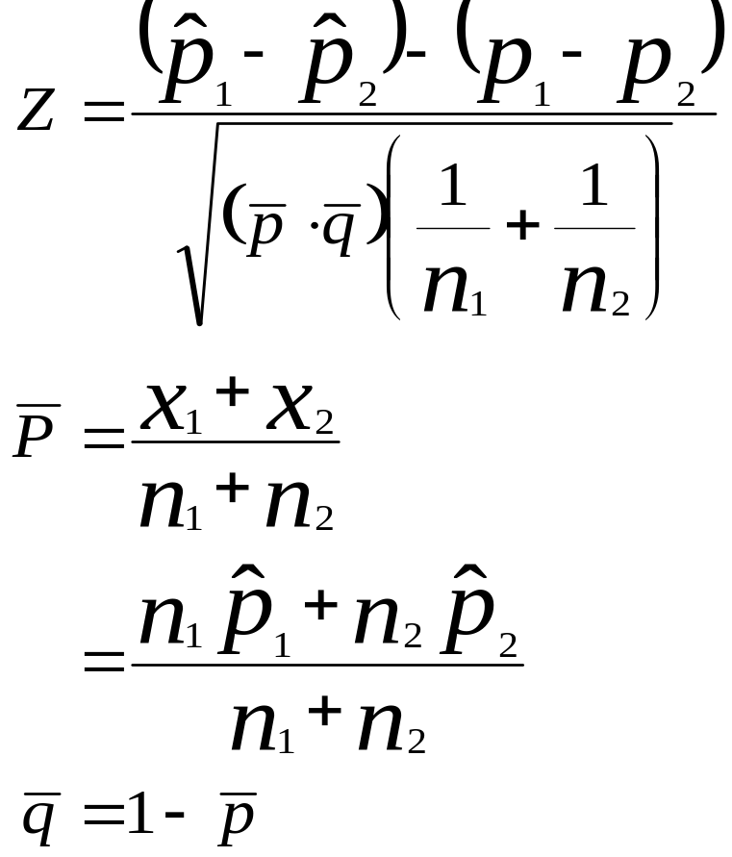
Z Formula to Test the Difference in Population Proportions
Notes:
41

Slide 31
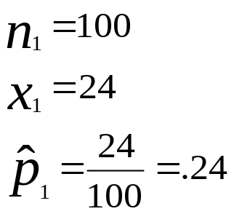
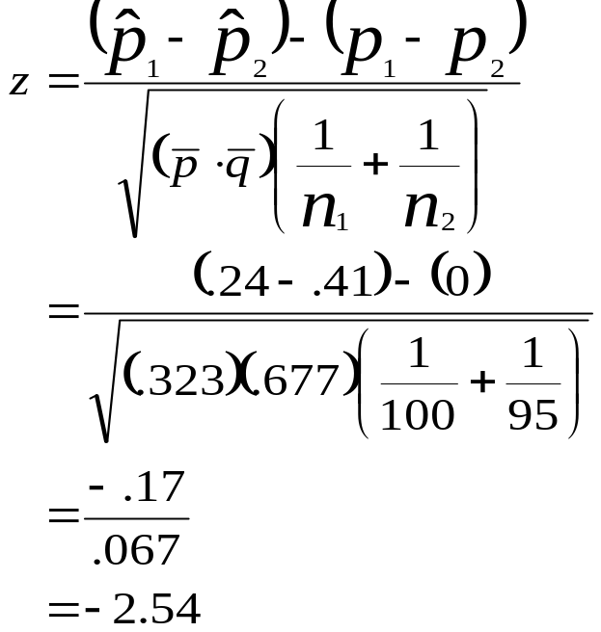
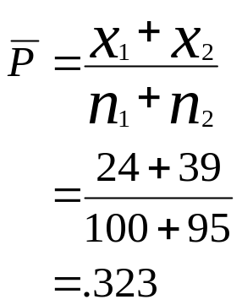
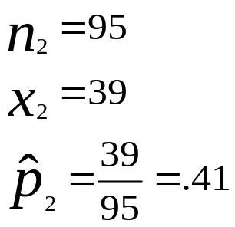
Testing the Difference in Population Proportions (Demonstration Problem 10.6)
H₀: p₁ – p₂ = 0
H_{a}: p₁ – p₂ ≠ 0
Notes:
43

Slide 32
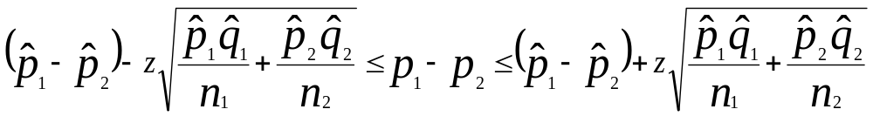
Confidence Interval to Estimate p₁ - p₂
Notes:
44

Slide 33
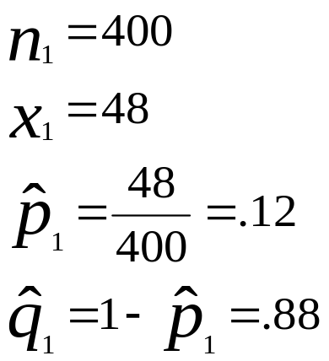
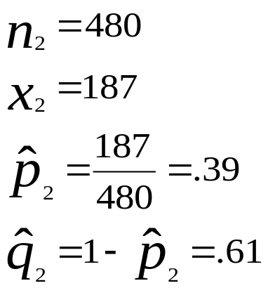
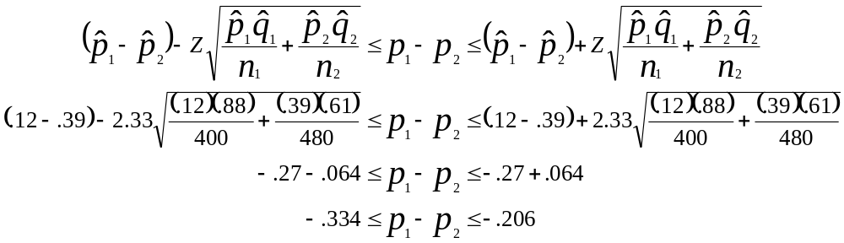
Example Problem: When do men shop for groceries?
For a 98% level of confidence
z = 2.33.
Notes:
45

